Slide 1
The Scientific Method for Getting Technology to Market
Steve Blank
www.steveblank.com
Twitter: @sgblank

Slide 2
The Scientific Method for Getting Technology to Market
Steve Blank
www.steveblank.com
Twitter: @sgblank

Slide 3
How to Fail Less When Bringing Technology to Market
Steve Blank
www.steveblank.com
Twitter: @sgblank

Slide 4
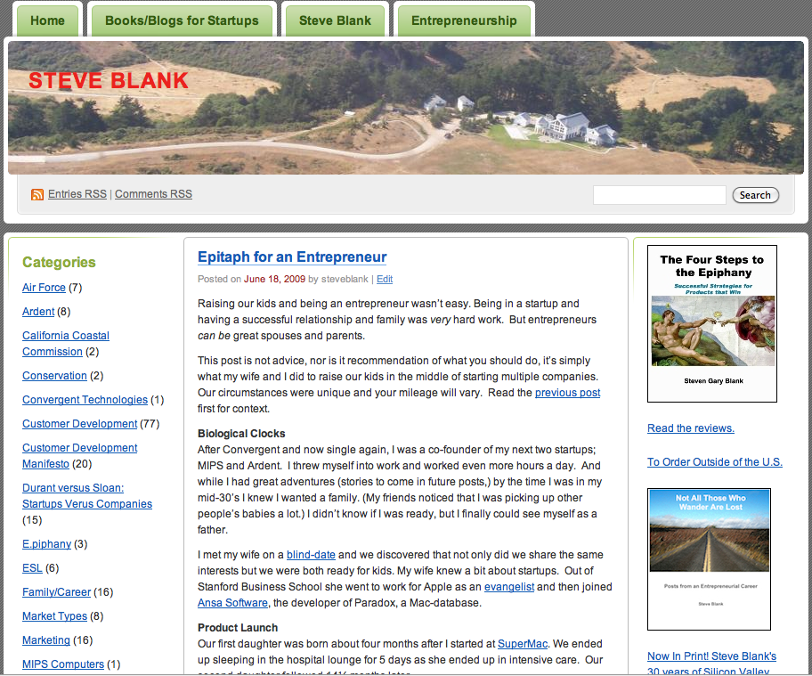
I Write a Blog
www.steveblank.com

Slide 5
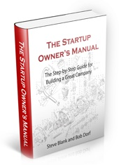


This Talk is Based On
Business Model Generation
Four Steps to the Epiphany
The Startup Owners Manual
www.steveblank.com

Slide 6
The "abc's of innovation
Lesson 1

Slide 7
Startups Are Not Smaller Versions of Large Companies

Slide 8
Startups Are Not Smaller Versions of Large Companies
Large Companies Execute Known Business Models

Slide 9
Startups Are Not Smaller Versions of Large Companies
Startups Search for Unknown Business Models

Slide 10
Startups Fail Because They Confuse Search with Execute

Slide 11
Startups Search, Companies Execute
The Execution of the Business Model
Scalable
Startup
Transition
Large Company
Repeatable processes
Knowns:
customers, features,
channels, pricing, etc
Execution
Understood Job Functions

Slide 12
Startups Search and Pivot
The Search for the Business Model
Scalable
Startup
Transition
Large Company
Business Model found by founders
Solving for unknowns
Searching for a match:
customer needs ➔ ⬅ product features
i.e. Product/Market fit
Repeatable sales model

Slide 13
Metrics Versus Accounting
The Execution of the Business Model
Scalable
Startup
Transition
Large
Company
Traditional Accounting
Balance Sheet
Cash Flow Statement
Income Statement

Slide 14
Metrics Versus Accounting
The Search for the Business Model
The Execution of the Business Model
Scalable
Startup
Transition
Large
Company
Startup Metrics
Average Selling Price/Order Size
Customer Acquisition Cost
Customer Lifetime Value
Monthly burn rate
etc.
Traditional Accounting
Balance Sheet
Cash Flow Statement
Income Statement

Slide 15
Customer Validation Versus Sales
The Execution of the Business Model
Scalable
Startup
Transition
Large
Company
Sales
Sales Organization
Job titles and functions
Price List/Data Sheets
Revenue Plan

Slide 16
Customer Validation Versus Sales
The Search for the Business Model
The Execution of the Business Model
Scalable
Startup
Transition
Large
Company
Customer Validation
Early Adopters
Pricing/Feature unstable
Not yet repeatable
“One-off’s”
Sales
Sales Organization
Scalable
Price List/Data Sheets
Revenue Plan

Slide 17
Waterfall Engineering Versus Agile Development
The Execution of the Business Model
Scalable
Startup
Transition
Large Company
Engineering
Requirements Docs.
Waterfall Development
QA
Tech Pubs

Slide 18
Engineering Versus Agile Development
The Search for the Business Model
The Execution of the Business Model
Scalable
Startup
Transition
Large Company
Agile Development
Continuous Deployment
Continuous Learning
Self Organizing Teams
Minimum Feature Set
Pivots
Engineering
Requirements Docs.
Waterfall Development
QA
Tech Pubs

Slide 19
Startups Model, Companies Plan
The Execution of the Business Model
Scalable
Startup
Transition
Large Company
Business Plan
describes “knowns”
features
customers/markets/channel
pricing
revenue forecast

Slide 20
Startups Model, Companies Plan
The Search for the Business Model
The Execution of the Business Model
Scalable
Startup
Transition
Large Company
Business Model
describes “unknowns”
customer needs
feature set
business model
found by iteration
Plan describes “knowns”
Known features for line extensions
Known customers/markets
Known business model

Slide 21
Large Company Product Introduction Plan
Concept/ Seed Round
Product Dev.
Alpha/Beta Test
Launch/
1st Ship

Slide 22
When Adopted by Startups =
The Leading Cause of Startup Death
Concept/ Seed Round
Product Dev.
Alpha/Beta Test
Launch/
1st Ship

Slide 23
Product Introduction Plan: Two Implicit Assumptions
Customer Problem: known
Concept/ Seed Round
Product Dev.
Alpha/Beta Test
Launch/
1st Ship
Product Features: known

Slide 24
Execute the Business Plan

Slide 25
Large Company Method – Hire Marketing
Concept/ Seed Round
Product Dev.
Alpha/Beta Test
Launch/
1st Ship
Create Marcom
Materials
- Create Positioning
- Hire PR Agency
- Early Buzz
- Create Demand
- Launch Event
- “Branding”
Marketing

Slide 26
Large Company Method – Hire Sales
Concept/ Seed Round
Product Dev.
Alpha/Beta Test
Launch/
1st Ship
Create Marcom
Materials
- Create Positioning
- Hire PR Agency
- Early Buzz
- Create Demand
- Launch Event
- “Branding”
Marketing
Sales
Hire Sales VP
Hire 1st Sales Staff
Build Sales Organization

Slide 27
Large Company Method – Hire Business Development
Concept
Product Dev.
Alpha/Beta Test
Launch/
1st Ship
Create Marcom
Materials
- Create Positioning
- Hire PR Agency
- Early Buzz
- Create Demand
- Launch Event
- “Branding”
Marketing
Sales
Hire Sales VP
Pick distribution Channel
Build Sales Channel / Distribution
Business
Development
Hire First Bus Dev
Do deals for FCS

Slide 28
Large Company Method – Hire Engineering
Concept
Product Dev.
Alpha/Beta Test
Launch/
1st Ship
Create Marcom
Materials
- Create Positioning
- Hire PR Agency
- Early Buzz
- Create Demand
- Launch Event
- “Branding”
Marketing
Sales
Hire Sales VP
Pick distribution Channel
Build Sales Channel / Distribution
Business
Development
Hire First Bus Dev
Do deals for FCS
Engineering
Write MRD
Waterfall
Q/A
Tech Pubs

Slide 29
Lets Change The Definition of a Startup
Lesson 2

Slide 30
Theory

Slide 31
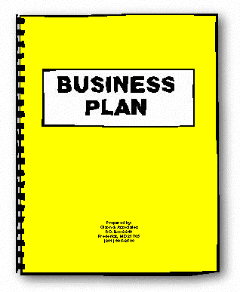
All I Need to Do is Execute the Plan

Slide 32
Reality

Slide 33
No Business Plan Survives First Contact With Customers

Slide 34
Lets Change the Definition

Slide 35
A Startup is a temporary organization

Slide 36
A Startup is a temporary organization designed to search

Slide 37
A Startup is a temporary organization designed to search for a repeatable and scalable business model

Slide 38
Startups need their own tools, different from those used in existing companies

Slide 39
Startups need their own tools, different from those used in existing companies

Slide 40
The 3 Tools For Startups
Lesson 3

Slide 41
Startup Tool #1: Agile Engineering

Slide 42
Agile Engineering is How We Build Startups

Slide 43
Agile Engineering is the antithesis of Waterfall Development

Slide 44
Agile Engineering is the antithesis of Waterfall It admits “We Cannot Know All the Features Customers Need”

Slide 45
Agile Engineering is the antithesis of Waterfall It admits “We Cannot Know All the Features Customers Need” So lets build iterative and incrementally

Slide 46
Startup Tool #2: The Business Model

Slide 47
The Business Model:
Any company can be described in 9 building blocks

Slide 48


Slide 49
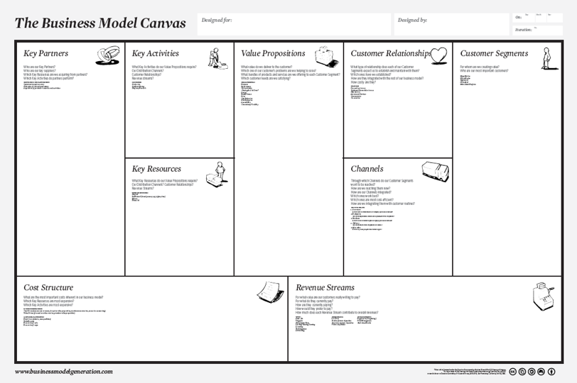
sketch out your business model

Slide 50

Business Model Canvas – Any Business
KEY
PARTNERS
KEY
ACTIVITIES
OFFER
CUSTOMER RELATIONSHIPS
CUSTOMER
SEGMENTS
building
block
building
block
building
block
building
block
building
block
building
block
KEY
RESOURCES
CHANNELS
building
block
building
block
building
block
COST STRUCTURE
REVENUE STREAMS
building
block
building
block
building
block

Slide 51
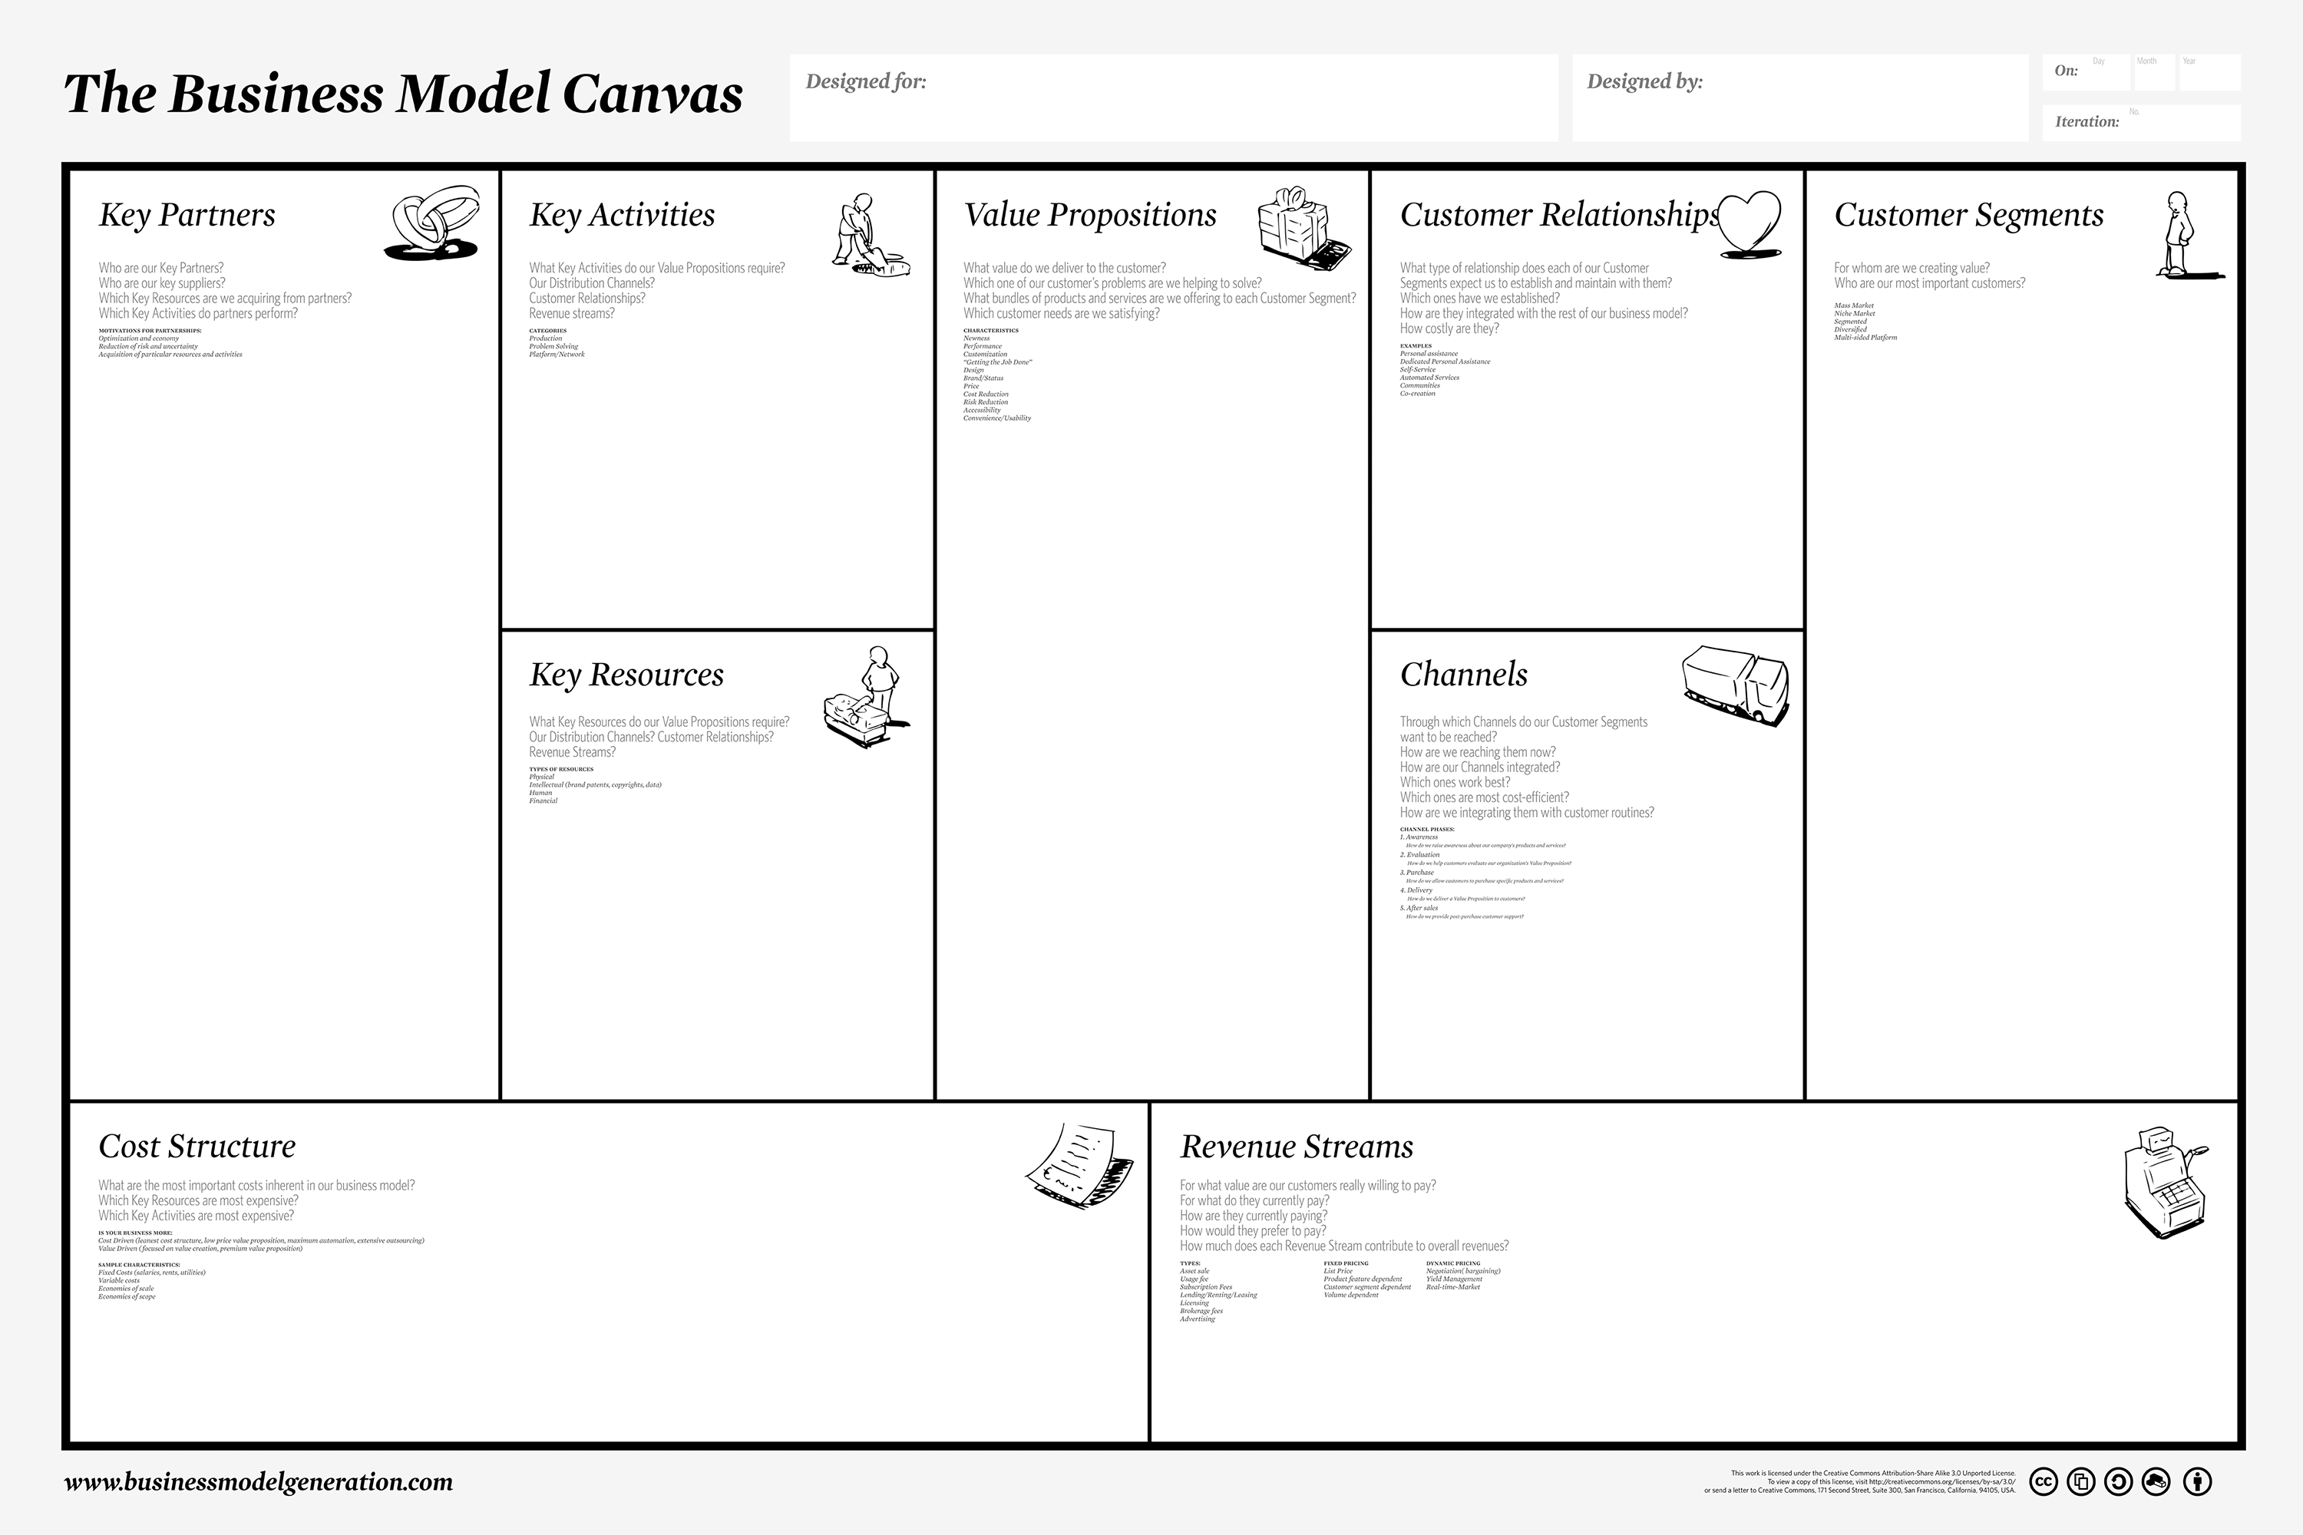
9 Guesses
Guess
Guess
Guess
Guess
Guess
Guess
Guess
Guess
Guess

Slide 52
Startup Tool #3: Customer Development

Slide 53
Customer Development is How We Search for the Business Model

Slide 54
Customer Development
Lesson 4

Slide 55
Customer Development
There are no facts inside your building
So get the heck out

Slide 56

Customer Development is how you search for the model
Search
Execution
Customer Discovery
Customer Validation
Customer Creation
Company
Building
Pivot

Slide 57
Customer Development
The Search For the Business Model
Search
Customer Discovery
Customer Validation
Pivot

Slide 58
Customer Development
Execution
Customer Discovery
Customer Validation
Customer Creation
Company
Building
Pivot

Slide 59
Customer Discovery
Search
Customer Discovery
Customer Validation
Customer Creation
Company
Building
Pivot
Execution
Articulate and Test your hypotheses
Design experiments, start listening
Continuous Discovery
Done by founders

Slide 60
Discovery
How big is the market?
Who’s the customer?
What’s their problem/need
What’s the product/service/need?
Does it solve the customers problem?
How do you create demand?
How do you deliver the product?
How do you make money?

Slide 61

Customer Development = process to search Business Model Canvas = the Scorecard Agile Engineering is How We Build Startups
Technology Design
Marketing
Demo and customer feedback
Farming conventions.
Demo, demo, and demo!!
Proximity is paramount
Research Labs
Equipment Manufacturers
Distribution Network
Service Providers
Cost Reduction
Remove labor force pains
Eliminate bio-waste hazards
Organic Farmers
Weeding Service Providers
Conventional Farmers
IP – Patents
Video Classifier Files
Robust Technology
Dealers
Direct Service
Indirect Service
… then Dealers
Value-Driven
Asset Sale
Direct Service with equipment rental
… then Asset Sale

Slide 62
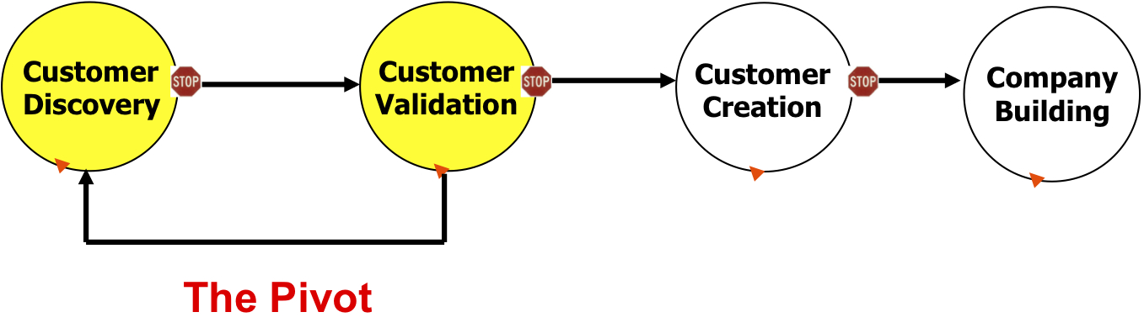
The Minimum Viable Product (MVP)
Smallest feature set that gets you the most …
- orders, learning, feedback, failure…
- incremental and iterative

Slide 63
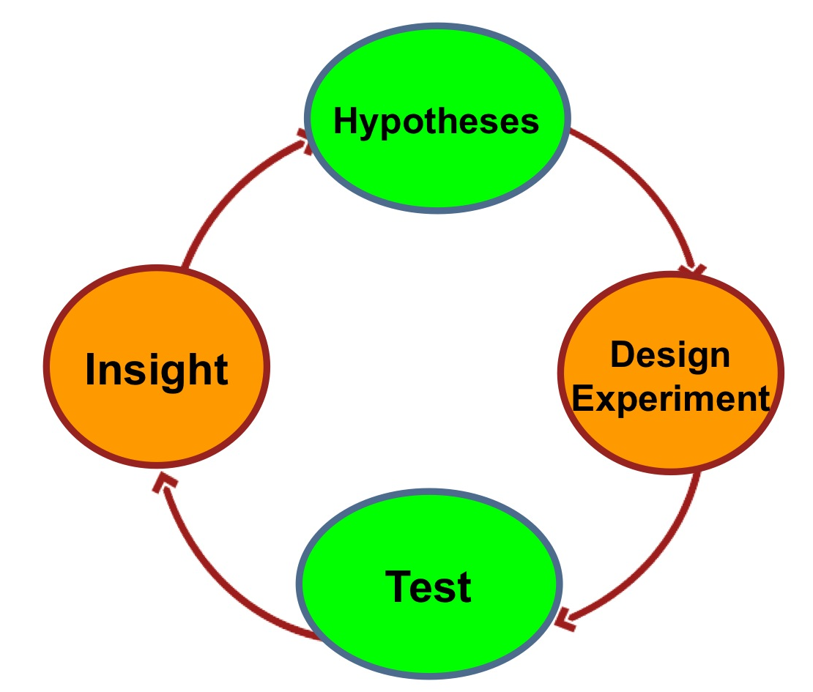
Hypotheses Testing and Insight

Slide 64
Customer Validation
Search
Customer Discovery
Customer Validation
Customer Creation
Company
Building
Pivot
Execution
Repeatable and scalable business model?
Passionate earlyvangelists?
Pivot back to Discovery if no customers

Slide 65
The Pivot
Search
Customer Discovery
Customer Validation
Pivot
The heart of Customer Development
Iteration without crisis
Fast, agile and opportunistic

Slide 66
Instead of Firing Founders When They Don’t Make the Plan

Slide 67
Instead of Firing Founders When They Don’t Make the Plan First, Fire the Plan

Slide 68
Pivot Cycle Time Matters
Search
Execution
Customer Discovery
Customer Validation
Customer Creation
Company
Building
Pivot
Speed of cycle minimizes cash needs
Minimum feature set speeds up cycle time
Near instantaneous customer feedback drives feature set

Slide 69
How Does This Really Work? Lean LaunchPad Class
Lesson 4

Slide 70





How Does This Really Work? Lean LaunchPad Class
National Science Foundation

Slide 71
Startups to Large Companies

Slide 72
How Does This Really Work? The National Science Foundation
8 Weeks From an Idea to a Business

Slide 73


Slide 74



Graphene Frontiers
We are a nanotechnology materials company with a proprietary process for producing high quality, low cost, large area graphene films at commercial scale
48 Companies
70+ Conversations

Slide 75
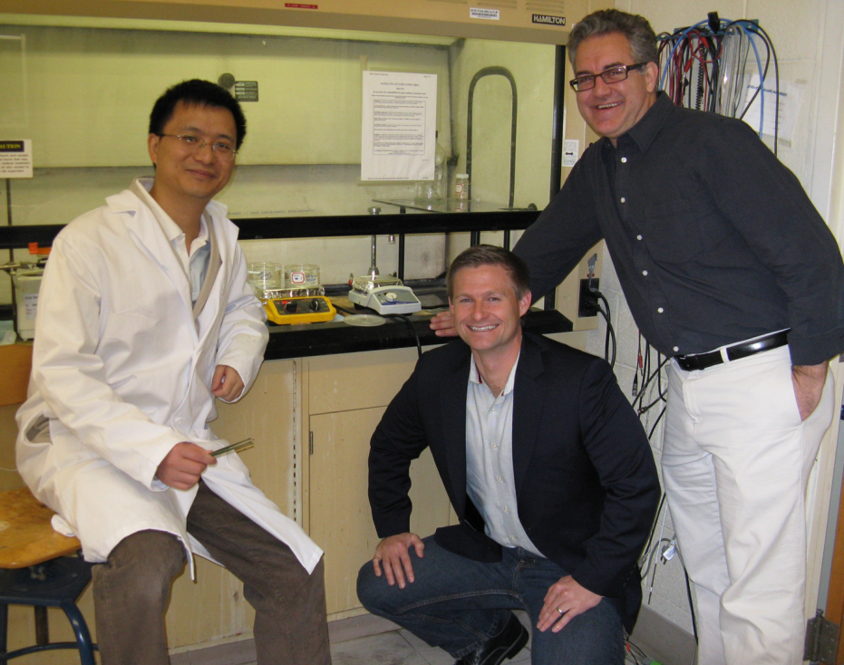
Team: Graphene Frontiers
EL: Zhengtang Luo, PhD – Chief Science Officer
10+ years experience in synthesis of carbon nanomaterials and product development for applications in the area of materials chemistry, chemical separation and electronic devices.
Mentor: Mike Patterson – CEO
Experienced entrepreneurial leader, manager, and trusted adviser to startups and Fortune 500 companies, providing expertise in growth strategy and international operations. Patterson is an Executive MBA candidate (Entrepreneurial Management, April 2012) at the Wharton School, University of Pennsylvania.
PI: A.T. Charlie Johnson, PhD – Founder, Scientific Advisory Board
Known internationally for his work in graphene electronics and carbon nanotube electronics. IP from his lab on DNA-carbon nanotube devices for use in an electronic nose system pursued by Nanosense. An author of over 130 peer-reviewed articles, Johnson holds two issued patents, with 18 other patents submitted.
Notes:
Rock Stars.

Slide 76
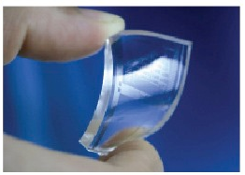
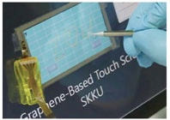
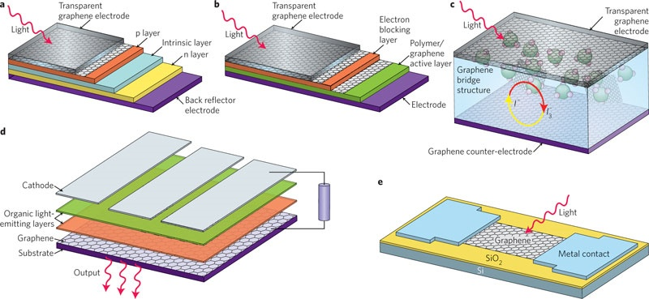
Background: Graphene Applications
“Wonder Material” Graphene
Nano Material Subject of 2010 Nobel Prize in Physics
2D Carbon: Strong, Flexible, Conductive, Transparent
Enables Next Generation Thin, Flexible Devices
Flexible Transparent
Electrodes
Thin, Flexible
Solar Cells
Touch Screen, Displays
Notes:
The Background: Graphene is an amazing material that will improve and disrupt entire industries, including electronics and clean energy

Slide 77
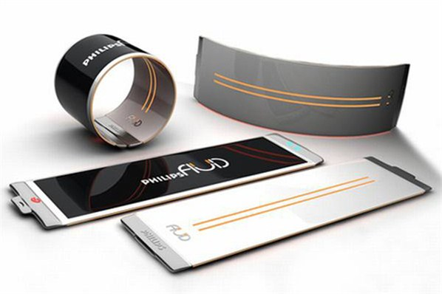



Problem: Lab Scale Not Enough
Graphene Production Must Scale Up to Commercial Levels before Integration into Consumer Products Becomes a Reality…
Notes:
Problem statement: None of these things will happen unless and until graphene can be produced in large quantities – Commercial Scale

Slide 78
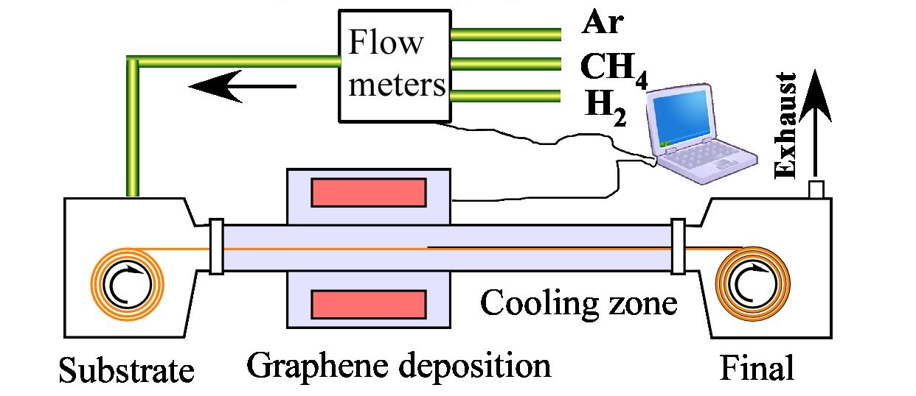
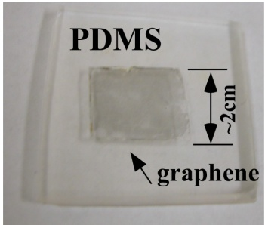

Solution: Scalable Production Process
Our Patent-Pending APCVD Graphene Production Process:
Operates at ambient pressure, reducing cost enabling flexible design
Industrial scale, continuous roll-to-roll production possible
Graphene sheet size limited only by CVD furnace dimensions
Same or better quality vis-à-vis LPCVD graphene
Graphene growth at 900-1000 °C, lower than other methods
Notes:
Solution: We can do this. Our technology offers the best path forward to enable commercial scale production of graphene films at low cost.

Slide 79
Market: Size and Growth
Nascent Graphene Market is Ready to Explode:
Commercial Scale Production will be Catalyst
Thin, Flexible Displays
Solar Thin Film
Touch Screens
Thermal Management for Electronics
Basic Materials and Research
Microscopy (TEM) Sample Supports
Thin, Flexible Display
$8.2B
Thermal Management
$6.4B
GF TAM:
$1.2B
Research/
Mat’l/Other
$1.4B
Market for
Graphene
Films/Sheets
Thin Film Solar
$4.6B
$52M
Graphene Frontiers Process & Product Offering
GF APCVD Process will Accelerate Graphene Adoption Curve
2012
2016
Notes:
Market Opportunity: We believe that there is significant demand for graphene, but the market will not develop and companies will not design products that incorporate graphene until a reliable source is identified

Slide 80
Recap
Graphene technology will change the world...
…but not until it is available in commercial volumes
We believe that APCVD is the best path to industrial scale
Whoever meets this challenge will be first mover in a fast growing market with multi-billion dollar potential
We are the right team with the right technology to do it
Notes:
We may have been overconfident.

Slide 81

Enter I-Corps: Beginning Hypotheses
Here’s What We Thought:
Graphene can be used for just about anything
All of the big manufacturers are just waiting for our product
The market for graphene will explode in 2012
We will become the world’s largest graphene manufacturer
Notes:
We may have been overconfident.

Slide 82







The Business Model Canvas - Version 1
R & D
Scale up system design
Graphene product.
IP creation/ licensing
Internal app. dev.
Lead Customer
Equipment Mfg
Universities
Downstream fabrication companies
Suppliers
Warranty
Service/Maint. Agree
Joint Marketing
Branding
Education
Material
Thermal Conduct.
Elect. Conduct
Strength
“Semiconductor”
Flexible
Transparent
Defense
MEMS
Chem/Bio Sensor
Researchers
Optoelectronics
Transparent Conduct. (Touch)
Solar Cell Electrodes
Thermal Mgmt
Supercapacitor
Battery
TEM support
Polymer/Compos.
CVD Equip Mfg
Process
Low Cost
Higher Quality
Large Area
“Industrializable”
Flexible Mfg
IP* (Patent/License)
Team/Expertise
Credibility/Rep
CVD Equipment
Inputs (gas/foil)
Lab space
Website
Design/Engineering
Distributor
Direct Sales
Online
License
Partner/JV
Bundle
Team
Lab space
Capital equipment
Direct Sales/Travel
Material Sales
License/Royalty
Equipment Sales
Consulting
Maintenance
Design
Add’l IP
Applications
Notes:
…using a cleaner template and underlining a few words. We settled on this as Graphene Frontiers Canvas #1 and thought that we would WOW the audience with how much detail we had and how broad our scope and opportunity was.
We projected this on the screen and were promptly booed off the stage. Sooo….. v2 was born:

Slide 83
So Here’s What We Did…
Research to identify target companies: Build the list
Web, industry/research reports, personal network, “Who else should we talk to?”
Calls to personal/professional/alumni network: “Do you know anyone…?”
Intros, warm calls, cold calls, cold calls, more calls
Notes:
We:
--Made a target list
--asked for introductions and referrals
--worked our networks
--made a BUNCH of calls

Slide 84
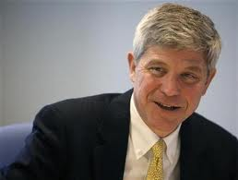

So Here’s What We Did…
Google AdWords Campaign + Survey Monkey
3 days, 8,555 Impressions, 34 people clicking through to our site, ZERO contacts/closes. Retrospect: What were we trying to learn???
Serendipity: Casual conversation turns to Graphene Frontiers at alumni event:
“That’s terrific! You know, I work at DuPont. Here’s my card… send me your deck and let me know how I can help.”
–Tom Connelly, Chief Innovation Officer, DuPont
Notes:
--Not successful: AdWords
--Very successful: Luck!!

Slide 85
So Here’s What We Did…
48 Companies Engaged, 70+ Conversations:
Lockheed Martin, GrafTech, Inventables, alphaMOS, FirstNano, Pannam Imaging, FujiFilm, Solutia, Dontech, Tramonto Circuits, Adamant Technologies, Intel, XG Sciences, Graphene Technologies, Densitron, Hotatouch, Touch International, Magic Touch, NJY Technology, Pangea Ventures, Display Search, Dow, DuPont, 3M, Corning, BASF, WL Gore, Morgan AM&T, Plextronics, SPI Supplies, New Metals and Chemicals, G.E., Innovalight, Siemens, Nelson-Miller, Essilor USA, Nexans, E-ink, Gamma Dynamics, Plastic Logic, Cabot Corporation, Thin Diamond, Knighthawk Engineering, Kopietz Consulting, DISPLAX, NineSigma, Evaporated Coatings, LiquaVista
80 LLL Posts, 61 Comments/Responses
79% comments positive or factual, 21% “Constructive”
Notes:
The numbers

Slide 86
Version 2 – Narrowed to 3 Customer Segments
Equipment Mfg
Scale up
Low Cost
Education
Thermal Mgmt Solutions
Universities
Customization
Higher Quality
Service/Maint.
Transparent Conduct. (Touch)
Production
Downstream fabrication companies
Large Area
“Industrializable”
Chem/Bio Sensor
IP
License
CVD Equipment
Direct Sales
Facilities/Lab
License/Royalty
Capital equipment
Personnel
Material Sales
Direct Sales/Travel
Lab space
Notes:
Lesson #1: Focus.
We narrowed our scope to the three applications we believed were most promising and set out to test our assumptions

Slide 87
So Here’s What We Learned…
Atmospheric pressure production is key value-add
Not “high-quality”, not single-layer
Many big companies are on the sidelines doing limited product dev, waiting for a proven production method
We need to focus on scaling up (bigger & faster)
We need a partner to break into consumer electronics
Cost matters, but not as much as we thought
Notes:
The Payoff:
--What we thought was important wasn’t important to our potential customers and partners
--The market *will not grow* until someone can prove that they can supply graphene
--The source must be reliable, and the cost must be within reason
**WE NEED TO DEMONSTRATE SCALE**

Slide 88
Version 3 – Manufacturing Wasn’t Our Business
Equipment Mfg
Scale up
Low Cost
Education
Thermal Mgmt Solutions
Universities
Customization
Higher Quality
Service/Maint.
Transparent Conduct. (Touch)
Production
Downstream fabrication companies
Large Area
“Industrializable”
Chem/Bio Sensor
IP
License
CVD Equipment
Direct Sales
Facilities/Lab
License/Royalty
Capital equipment
Personnel
Material Sales
Direct Sales/Travel
Lab space
Notes:
We were a bit too hesitant to fail fast and close doors, but we did recognize early on that we were probably not going to become “the Alcoa of nanocarbon”

Slide 89
So Here’s What We Learned…
TEM grids are viable, near term but small market
Will rely on distribution partner
Displays will be next big thing
Focus on flexible/foldable thin displays
May require partnership with OEMs or sub-contractors
Extensive product characterization is next step
Transparency, haze, sheet resistance for displays (3M, Dow, DuPont)
Minimize layers and contamination for TEM (SPI, Halcyon)
Notes:
We can make money TODAY with TEM Grids and material sales… distributors are clamoring for our stuff
We have work to do to meet display requirements
Big companies are willing to help us get there

Slide 90
Version 4 – Key Segment/Work with Other Products
Equipment Mfg
Scale up
Low Cost
Education
Thermal Mgmt Solutions
Universities
Customization
Higher Quality
Service/Maint.
Transparent Conduct. (Touch)
Production
Downstream fabrication companies
Large Area
“Industrializable”
Chem/Bio Sensor
IP
License
CVD Equipment
Direct Sales
Facilities/Lab
Intermediate product
License/Royalty
Capital equipment
Personnel
Material Sales
Direct Sales/Travel
Lab space
Notes:
We also heard from customers that we would need to integrate into existing production lines… high volume manufacturers may be reluctant to buy vast quantities of material… they probably want to license and make their own.
We also learned that ITO and silver nanowires were the competition for touch screen and displays, but we were beginning to quantify the differentiators

Slide 91
Version 5 – Explored/Ruled Out New Segment
Scale up
Equipment Mfg
Low Cost
Education
Thermal Mgmt Solutions
Customization
Service/Maint.
Universities
Higher Quality
Transparent Conduct. (Touch)
Collaborative R & D
Production
Downstream fabrication companies
Large Area
Membrane switches
IP
“Industrializable”
License
Replace ITO
CVD Equipment
Direct Sales
Facilities/Lab
Chem/Bio Sensor
Intermediate product
License/Royalty
Capital equipment
Personnel
Material Sales
Direct Sales/Travel
Lab space
Notes:
We heard that collaborative R&D would be a necessity—we will need to help companies use our material in their product development.
Membrane switches—a new opportunity we evaluated, was quickly ruled out.

Slide 92
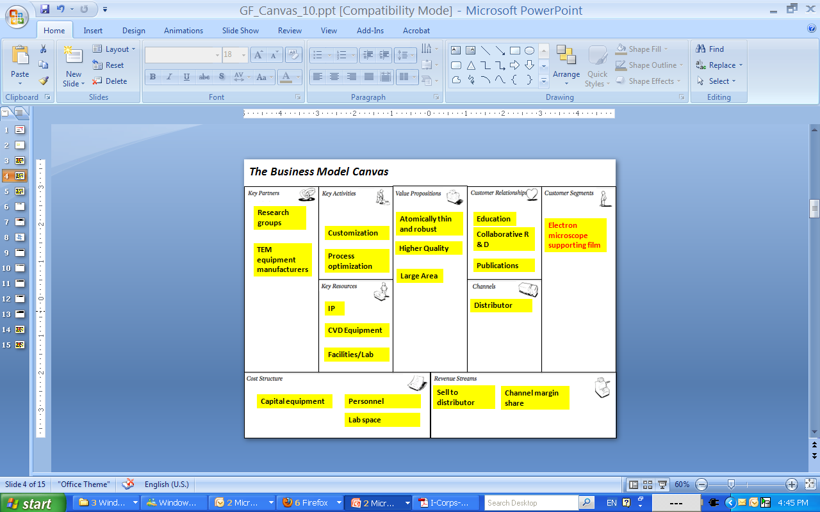
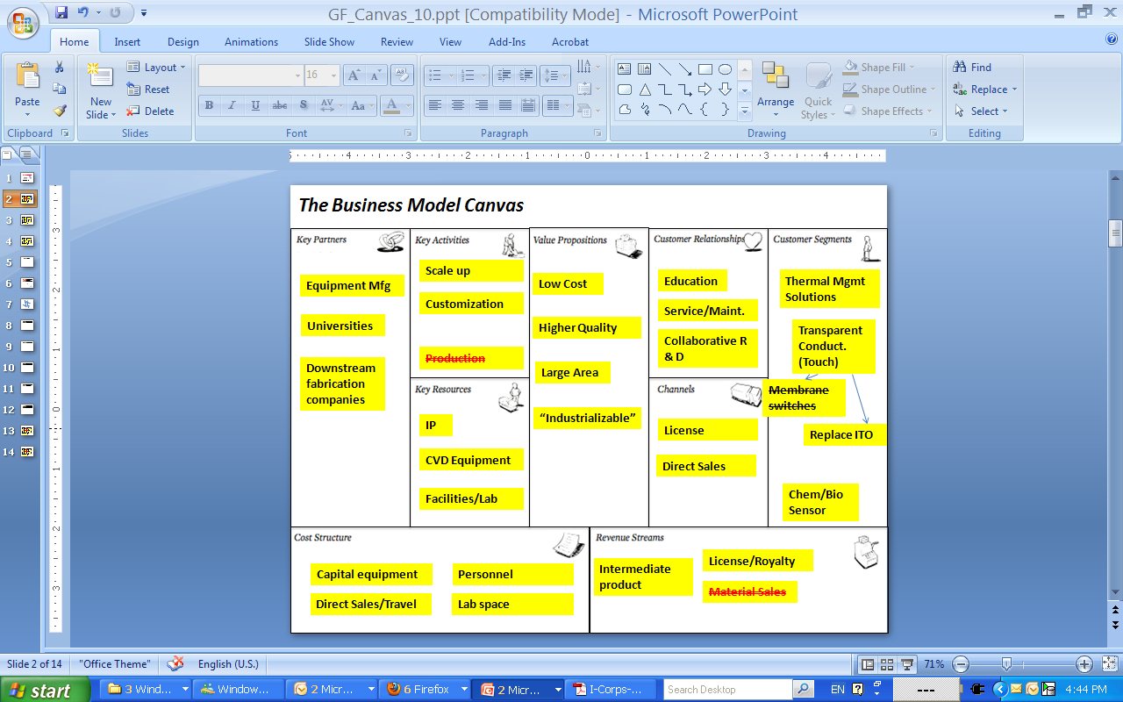
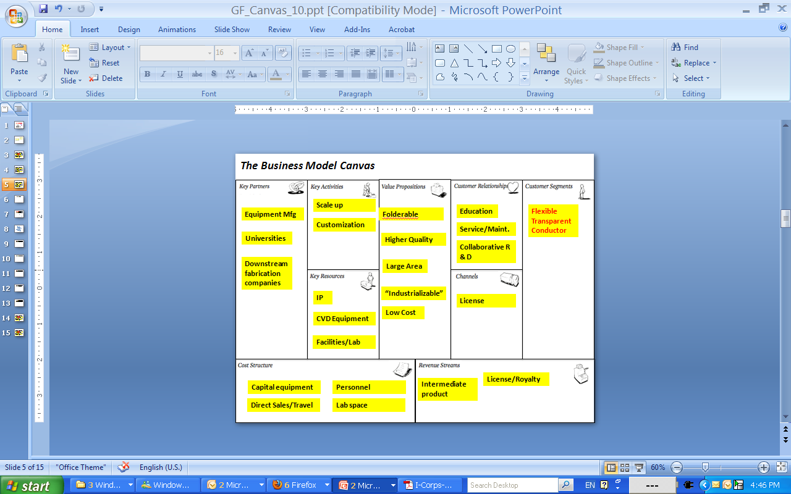
Pivot, into near term
and medium term
Notes:
The big week:
Near term opportunity: TEM Grids
Medium term opportunity: Thin, flexible displays

Slide 93
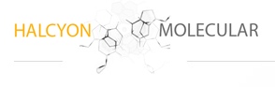
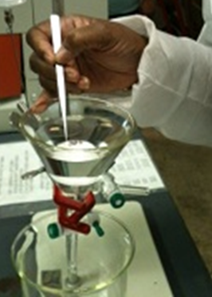
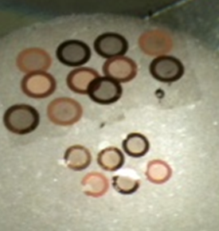

Version 6 – Near Term Business
Research Groups
Transfer Process Optimization
Academic Papers
Atomically Thin and Robust
Electron Microscopists
Trade Shows
TEM Equipment Mfg.
Higher Quality
“Clean”
IP
CVD Equipment
Facilities/Lab
“Free”
(Selling Byproduct)
Revenue Sharing
w/Distributor
Notes:
Canvas A: TEM Grids
We’re partnering with SPI, a microscopy supply distributor, and have developed a Minimum Viable Product that is undergoing beta testing and evaluation.
We will provide them with graphene on copper foil (a byproduct of our work to scale up production), and they will transfer to the grids, QC, package, market, sell, etc. and we have agree in principle on a revenue sharing deal

Slide 94
Version 7 – Mid-Term Business
Scale up
Equipment Mfg
Foldable / Bendable
Education
Flexible Transparent Conductor
Customization
Service/Maint.
Universities
Higher Quality
Collaborative R & D
Downstream Fabrication Companies
Large Area
“Industrializable”
IP
License
Low Cost
CVD Equipment
Facilities/Lab
Intermediate product
License/Royalty
Capital Equipment
Personnel
Direct Sales/Travel
Lab space
Notes:
We learned that we needed to partner with manufacturers to incorporate graphene into product development, and *SCALE UP IS CRITICAL*
Cost is not as important as we thought earlier,: We don’t need to beat ITO, we need to do what it can’t do (flexible, impervious to oxygen, etc.)

Slide 95
What’s Next: Strategy and Roadmap
1H 2012
Phase
4” Scale-Up
Product/
Revenue
TEM Grids
Materials Business
12” x 12” Sheet
Production
Milestone
Activity
Scale-Up Sheet Size
Increase Area
Notes:
So here’s the plan.

Slide 96
What’s Next: Strategy and Roadmap
1H 2012
2012
Phase
4” Scale-Up
Commercial Roll-to-
Roll Design & Prototype
Product/
Revenue
TEM Grids
Materials Business
12” x 12” Sheet
Production
Process Licensing
Roll-to-Roll Mfg.
Industrial Scale
Milestone
Perfect
Continuous Process
Activity
Scale-Up Sheet Size
Increase Area Increase Throughput
Notes:
So here’s the plan.

Slide 97
What’s Next: Strategy and Roadmap
1H 2012
2012
2013+
Phase
Commercial Roll-to-
Roll Design & Prototype
Application
Development
4” Scale-Up
Product/
Revenue
TEM Grids
Materials Business
12” x 12” Sheet
Production
Process Licensing
Roll-to-Roll Mfg.
Industrial Scale
Intellectual Property
Thin, Flexible Displays
Application R&D
Team
Milestone
“World Leader in
CVD Graphene
Innovation”
Activity
Perfect
Continuous Process
Scale-Up Sheet Size
Increase Area Increase Throughput New Applications
Notes:
So here’s the plan.

Slide 98

What’s Next: Secure Partnerships + Investment
Distribution Partners
Notes:
We’re now ready to raise money to scale up and develop our continuous manufacturing prototype, and we have several heavy hitters who are waiting to see us succeed…

Slide 99








What’s Next: Secure Partnerships + Investment
Distribution Partners
Active Customer Conversations
Notes:
We’re now ready to raise money to scale up and develop our continuous manufacturing prototype, and we have several heavy hitters who are waiting to see us succeed…

Slide 100
What’s Next: Secure Partnerships + Investment
Distribution Partners
Active Customer Conversations
Manufacturing Partners
?
Notes:
We’re now ready to raise money to scale up and develop our continuous manufacturing prototype, and we have several heavy hitters who are waiting to see us succeed…

Slide 101


Slide 102

21 Teams in 2011 200 teams/year 2012 National University Network
Stanford University of Michigan Georgia Tech Others to be announced

Slide 103
National Science Foundation
I-Corps
ERC
I/UCRC
SBIR
GOALI
AIR/PFI
STTR
STC
Industry
Investors
NSF Primary Funding
Resources Invested
“Ditch of Death”
Valley of Death
Foundations
Small Business
University
Discovery
Development
Commercialization
Notes:
This is a depiction of the resources available vs the stage from Discovery to Commercialization.
The left-hand side is primarily the realm of public support and the right-hand side is primarily the realm of the private sector.
The vast majority (centroid, if you will) of NSF funding has been and will continue to be in the Discovery range. It is our core and we will not waiver in support of this. We also, to a much smaller extent, support collaborations with industry and even support innovation research in for-profit sector with our SBIR program. Many people don’t know but, the SBIR program (the hallmark of the Federal government’s support on innovation research) was piloted by NSF and it continues to be a flagship for us. The I-Corps home is post “not-for-profit fundamental research” and pre “for-profit innovation research”… the “Ditch of Death”
The existence of the “valley of death” is well known The I-Corps program focuses on the Ditch of Death” Ask any entrepreneur who has tried to spin technology out of an Academic lab about the challenge of getting funds for developing product demos. Show them this slide, they’ll get the I-Corps home/sweet spot immediately!

Slide 104
Crossing “The Ditch of Death”
I-Corps
ERC
I/UCRC
SBIR
GOALI
AIR/PFI
STTR
STC
Industry
Investors
NSF Primary Funding
Resources Invested
“Ditch of Death”
Valley of Death
Foundations
Small Business
University
Discovery
Development
Commercialization
Notes:
This is a depiction of the resources available vs the stage from Discovery to Commercialization.
The left-hand side is primarily the realm of public support and the right-hand side is primarily the realm of the private sector.
The vast majority (centroid, if you will) of NSF funding has been and will continue to be in the Discovery range. It is our core and we will not waiver in support of this. We also, to a much smaller extent, support collaborations with industry and even support innovation research in for-profit sector with our SBIR program. Many people don’t know but, the SBIR program (the hallmark of the Federal government’s support on innovation research) was piloted by NSF and it continues to be a flagship for us. The I-Corps home is post “not-for-profit fundamental research” and pre “for-profit innovation research”… the “Ditch of Death”
The existence of the “valley of death” is well known The I-Corps program focuses on the Ditch of Death” Ask any entrepreneur who has tried to spin technology out of an Academic lab about the challenge of getting funds for developing product demos. Show them this slide, they’ll get the I-Corps home/sweet spot immediately!

Slide 105
But This Can’t Possibly Work in Large Companies

Slide 106

Customer Development in GE Energy Storage 2010-2012

Slide 107

Durathon™ Battery Systems GE Energy Storage

Slide 108
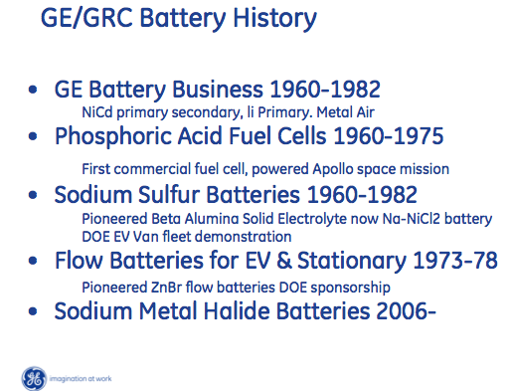

Slide 109
Make This a Billion Dollar Business

Slide 110
Build A $100M Factory

Slide 111
No

Slide 112
No, Let’s Get the Customers First

Slide 113
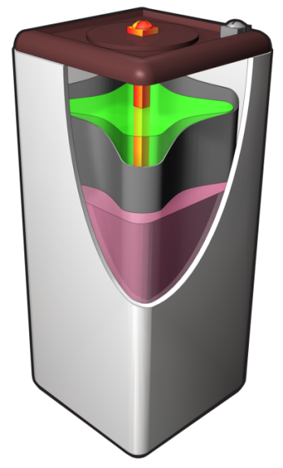
Cells and modules … building blocks of the DurathonTM system
Cell
High Power
Durathon
High Energy
Seconds
Minutes
Hours

Slide 114
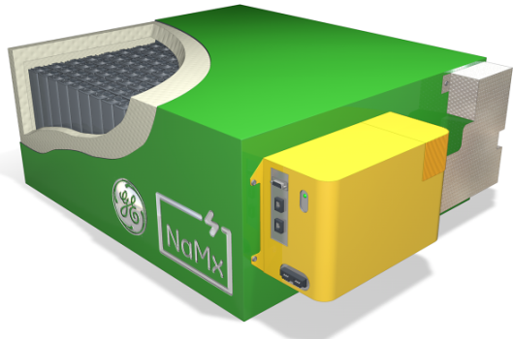
Cells and modules … building blocks of the DurathonTM system
Cell
Battery Module
(Application-Specific)
Telecom: 84 Cells
UPS: 216 Cells
High Power
Durathon
High Energy
Seconds
Minutes
Hours

Slide 115
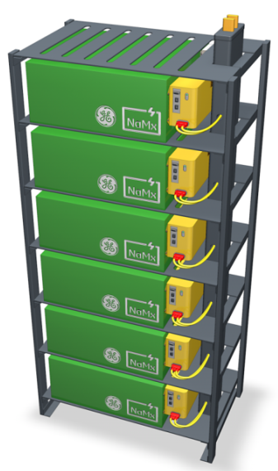
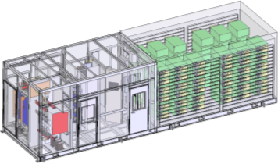
Cells and modules … building blocks of the DurathonTM system
Cell
Battery Module
(Application-Specific)
System
Telecom: 84 Cells
UPS: 216 Cells
10’
40’
High Power
Durathon
High Energy
Seconds
Minutes
Hours

Slide 116
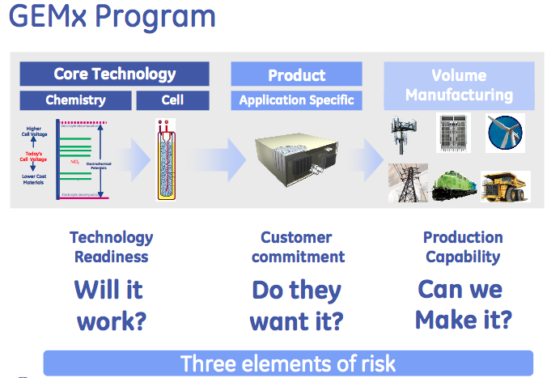

Slide 120
Segment Analysis
“No Plan Survives First Contact With Customers”
Size / Growth
Profitability
Price Premium
Cost to engage
Cost to serve
Technical Risk
Development Cost
explore
invest
Segment Attractiveness
ignore
harvest
Ability to Compete
Technical Fit
Perceived Value
Competitive forces
Adoption Cycle
Channel fit

Slide 121
Assess and Prioritize Opportunities
Customer Discovery
EV
Rail
Mining
Signaling / Security
Grid / Utility
Material Handling
Military
1
Requires in-depth understanding of benefits sought by customers

Slide 122
Assess and Prioritize Opportunities
Customer Discovery
EV
Rail
Mining
Signaling / Security
Grid / Utility
Material Handling
Military
1
JUDGMENT-BASED
Generate Hypotheses
Interpret Results
Intuitive
“Why?”
Requires in-depth understanding of benefits sought by customers

Slide 123
Assess and Prioritize Opportunities
Customer Discovery
Customer Validation
EV
Rail
Mining
Signaling / Security
Grid / Utility
Material Handling
Military
Market 1, 2, 3, . . . .
1
2
JUDGMENT-BASED
DATA-DRIVEN
Generate Hypotheses
Interpret Results
Intuitive
“Why?”
Test Hypotheses
Analyze Data
Deductive
“Why?” and “What?”
Requires in-depth understanding of benefits sought by customers

Slide 124
Market Screening
Discussions with ~50 different “customers”
Clustered into 15 Different Segments
EV – Small
Commercial EV
Passenger EV
Mining
Marine
Rail
APU
Fire & Security
Signaling
Communications
Wind
Solar
T&D Deferral
Building Level
OEM - BESS Grid

Slide 125
Customer development plan
2010 |  |  |  |  |  | 2011 |  |  |  |  |  |  |  |  |  |  |  | 2012
Jul | Aug | Sep | Oct | Nov | Dec | Jan | Feb | Mar | Apr | May | Jun | Jul | Aug | Sep | Oct | Nov | Dec | Jan | Feb | Mar
State Hypotheses
Test Problem & Product Hypotheses
Verify
Customer Discovery

Slide 126
Customer development plan
2010 |  |  |  |  |  | 2011 |  |  |  |  |  |  |  |  |  |  |  | 2012
Jul | Aug | Sep | Oct | Nov | Dec | Jan | Feb | Mar | Apr | May | Jun | Jul | Aug | Sep | Oct | Nov | Dec | Jan | Feb | Mar
State Hypotheses
Test Problem & Product Hypotheses
Verify
Customer Discovery
Prep to Sell
Customer Validation
Sell to EarlyVangelists
Develop Positioning

Slide 127
Customer development plan
2010 |  |  |  |  |  | 2011 |  |  |  |  |  |  |  |  |  |  |  | 2012
Jul | Aug | Sep | Oct | Nov | Dec | Jan | Feb | Mar | Apr | May | Jun | Jul | Aug | Sep | Oct | Nov | Dec | Jan | Feb | Mar
State Hypotheses
Test Problem & Product Hypotheses
Verify
Customer Discovery
Prep to Sell
Customer Validation
Sell to EarlyVangelists
Develop Positioning
Ready to Launch
Position Company & Product
Create Demand
Customer Creation
Launch GEES & Durathon

Slide 128
Customer development plan
2010 |  |  |  |  |  | 2011 |  |  |  |  |  |  |  |  |  |  |  | 2012
Jul | Aug | Sep | Oct | Nov | Dec | Jan | Feb | Mar | Apr | May | Jun | Jul | Aug | Sep | Oct | Nov | Dec | Jan | Feb | Mar
State Hypotheses
Test Problem & Product Hypotheses
Verify
Customer Discovery
Prep to Sell
Customer Validation
Sell to EarlyVangelists
Develop Positioning
Ready to Launch
Position Company & Product
Create Demand
Customer Creation
Company Building
Launch GEES & Durathon
Crossing the Chasm
Move from EarlyVangelists to Mainstream Customers

Slide 129
GEMX Business Model Scorecard critical pending actions
Key Partners
Who are our key partners/ suppliers
Key Activities
Which key activities does the biz model require
Value Proposition
What value do we deliver to the customer
Customer Relationships
What type of relationship does each segment require of us
Customer Segments
For whom are we creating value
Complete regional overview
Populate life cycle data for performance guarantees
Educate market on metric: $/kWh-day delivered over life of asset
Establish strong partnerships with channel partners
key distinctive product features & benefits for the target customer segment
total cost of ownership for segment versus alternatives
why will segment buy Durathon versus alternatives (i.e. value proposition)
minimum feature set (i.e. our launch configuration) and ultimate feature set
opportunities to claim IP or trademark / is there freedom to practice
what regulatory/ certification/ transportation/ customs requirements should be met or could be differentiator
product positioning/elevator pitch for each segment
Prospect roadmap: how to get face-to-face with right person at prospects in each segment
key competitors in each segment and their market share
key competitors' characteristics & dynamics
What outbound marketing/ advertising/ promotion activities are needed
support tools required by segment (white papers, TCO calc., tradeshow)
pipeline of leads
identify key market segments (geography/application) and customer segments (e.g. operator versus owner)
how many customers in each segment and estimated potential volume for each customer
how do customers make money … key customer pain/gain points in each segment
how are buying decisions made in each segment - id process, hurdles, decision makers
what does an Earlyvangelist look like in each segment
who influences purchases in each segment (trade groups, key resellers, trend watchers)
0
Key Resources
Which key resources does the biz model require
25
Channels
Through which channel does each segment want to be reached
Integrated power system engineering – compatibility for retrofit and optimized system solutions
Financing options for Power services operators
which segments can only or best be reached through a channel partner
which channel partners are important to optimize sales in each segment
what are channel partners' requirements and cost to become a proactive sales channel
initial channel partner response to value proposition & customer segments
12
25
4
50
Cost Structure
What are our cost drivers
Revenue Streams
How much is each segment willing to pay and how would they like to pay us this amount
Launch reliability
What are price /performance characteristics of competing technology
What is the 2013 price target for 1 MM cells
What is the 2015 price target for 10 MM cells
what is optimum sales method for each segment (asset sale, lease, pay for performance, etc.)
3
X = number of in depth customer data points / data sources used to validate hypothesis
red = low hypothesis confidence
yellow = medium hypothesis confidence
green = high hypothesis confidence
x
x
x

Slide 130
PIVOT: End Users, More Markets
“Partners” really wanted orders to fill, no risk, not a partnership
Channel partners expected GEMx to deliver customers
Initiate High-Speed End-User Customer Discovery
Value Proposition values notably by channel, user, geography

Slide 131
PIVOT: END USERS
Not all customers alike, even in identical verticals
Customer segmentation emerges: how they use, evaluate, buy, manage
Value proposition and pricing vary by customer use, metric
Openness to new technology, speed of piloting become key issues

Slide 132
PIVOT: END USERS
Not all customers alike, even in identical verticals
Customer segmentation emerges: how they use, evaluate, buy, manage
Value proposition and pricing vary by customer use, metric
Openness to new technology, speed of piloting become key issues
Focused Segment strategy; Value Prop varies by segment
Focus on <8 hours of grid/day, extreme temperature climates
Segment said “recharge rate” important to value proposition
Energy produced per day a key Value Proposition in this market

Slide 133
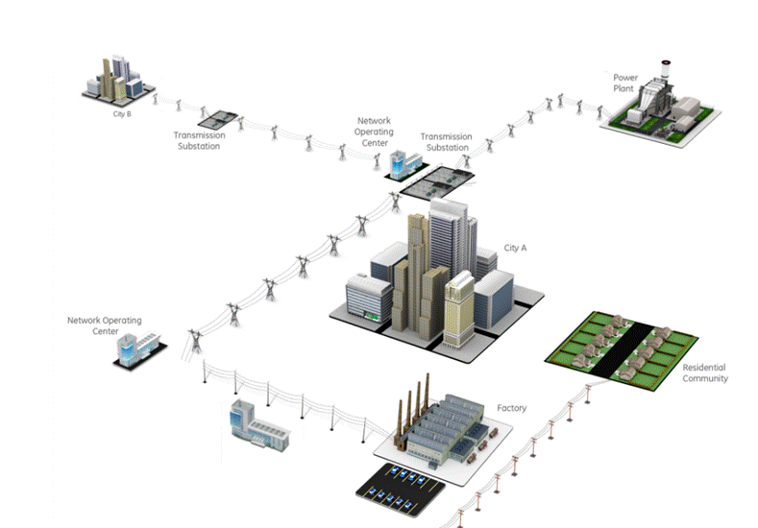


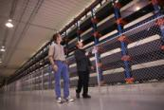

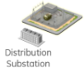
Energy Storage on The Grid
$1.5B in 2010, to $35.3B annually by 2020*
T&D Support
Time Shifting
Supply Capacity
T&D Deferral
Load Following
Area Regulation
T&D Support Example
Golden Valley Electric Association, Alaska
Renewables Integration
Firming
Smoothing
Curtailment
27 MW, 15 Minutes
$750-900 | $ / kW
1011 | Modules
226,517 | Cells
60 percent reduction
in power supply type outages
End User Applications
*Pike Research report
Time of Use
Demand Charge
Power Quality
Notes:
Our electrical infrastructure is becoming more complex as a result of the influx of cleaner, more efficient energy sources
Transmission lines will need to be constructed to carry power from off-shore wind farms to populated areas
As wind is integrated, intermittent and fluctuating power will require more advanced systems to be managed
Distributed generation will change grid dynamics from one-way to two-way power flow between utilities and customers
PHEVs will present challenges, requiring smart metering to encourage consumers not to plug in during peak hours and technologies that will bill the appropriate consumers regardless of his location at the time of re-charging.
This is all creating a more dynamic and integrated network and our power grid was not originally designed with this future in mind. The management and optimization of these elements will require a smarter power grid

Slide 134


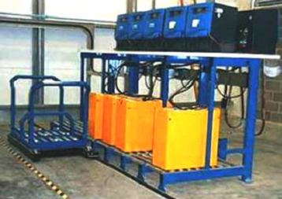


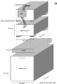
Cold Storage “Niche” for Durathon™ ? One battery vs Three to Four Batteries
3 – 6* batteries per 24 hour truck
24/7 warehouse operators
Enersys
Pb-acid
8 hr use
8 hr charge
8 hr cool
1.5 batteries per 24 hour truck
NaMx
Typical battery charging station Acid spill containment not shown.
8 hr use
8 hr charge
8 hr use
*Freezer operations require 4~6 Pb acid batteries / truck,
but only 1.5 Durathon batteries per truck !!

Slide 135
But What Does This Mean For You?

Slide 136
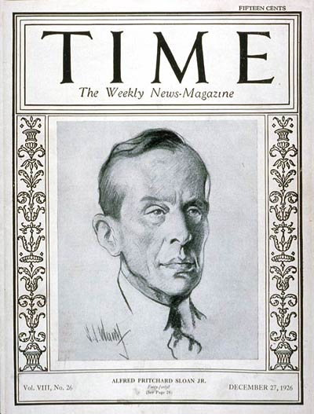
Inventor of the Modern Corporation
Scalable
Startup
Transition
Large Company

Slide 137
Inventor of the Modern Corporation
Scalable
Startup
Transition
Large Company
Alfred P. Sloan

Slide 138
Alfred P. Sloan
Scalable
Startup
Transition
Large Company
General Motors, President/Chairman
Cost Accounting
MIT Sloan School
Sloan Foundation
etc.

Slide 139
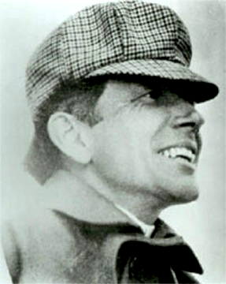
Founder of General Motors
Scalable
Startup
Transition
Large Company

Slide 140
Founder of General Motors
Scalable
Startup
Transition
Large Company
Billy Durant

Slide 141
Billy Durant
Scalable
Startup
Transition
Large Company
Leader in horse-drawn buggy’s
Fired by board, starts Chevrolet
Regains control of GM
Fired by board, GM ~$3.6 billion*
* GM Net sales in 1921 $304.5M = $3.6 Billion today

Slide 142
Durant Versus Sloan
Scalable
Startup
Transition
Large Company

Slide 143
Durant Versus Sloan
Dies, rich, honored and famous

Slide 144
Durant Versus Sloan
Dies managing a bowling alley
Dies, rich, honored and famous

Slide 145
Durant Versus Sloan
Accountant
Dies managing a bowling alley
Dies, rich, honored and famous

Slide 146
You are here
Scalable
Startup
Transition
Large Company

Slide 147
This Talk is Based On
Business Model Generation
Four Steps to the Epiphany
The Startup Owners Manual
www.steveblank.com

Slide 148

Book signing and copies of the Startup Owner’s Manual
4pm in the Students Room

Slide 149
I Write a Blog
www.steveblank.com

Slide 150
Thanks
www.steveblank.com

Slide 151

# of customers: ~85 people
Hydrogen sensors in Chlor-alkali

Slide 152

Founding Team
Dr. Jason Gu
Principal inventor
CEO and Entrepreneurial Lead
Dr. Peter Foller
Former Director of R&D Chemical and Optical, PPG Industries
Market Exploration and Acquisition
Prof. Robert F. Davis
Professor of Materials Science, CMU
National Academy of Engineering
Advisor and Mentor
Prof. Lisa M. Porter
Professor of Materials Science, CMU
Technological Development and Principal Investigator
Mr. Jacob Melby
Graduate Student, Carnegie Mellon University
Principal Engineering Specialist

Slide 153
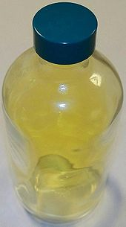
Major Commodity Market – Chlorine Production

Slide 154
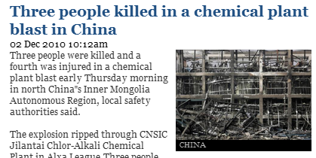
Major Commodity Market – Chlorine Production
Thorn in the lion’s paw (184 incidents in Europe, 4yrs)
Plant cost: $1B
Co-produced
H₂ + Cl₂ =

Slide 155
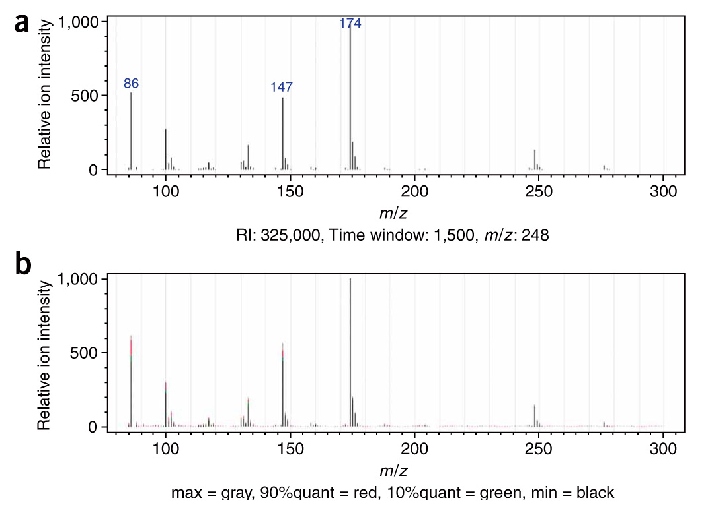
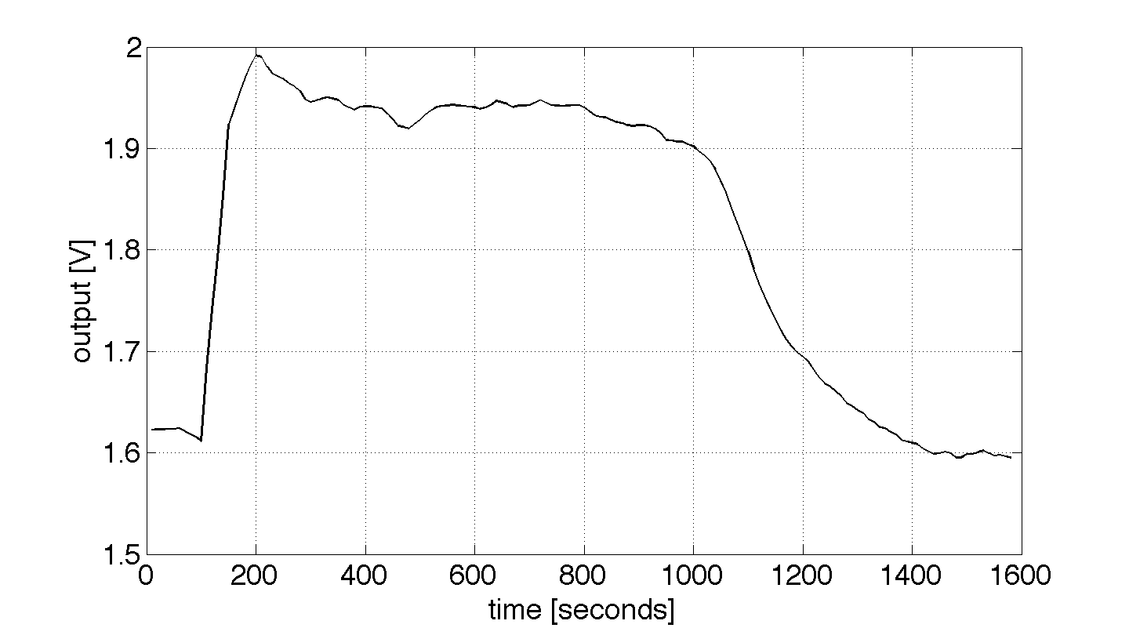

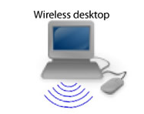

[Current Standard-Operating Procedure]
Once a week monitoring
VS
[Innovation]
Real-time data
Licensed Novel technology
[H₂]
Hazardous Industrial Environments

Slide 156

Fragmented technologies and market
ensors market
2011: $5.6B (US) $15B (World)
2014: $6.1B (US) $20B (World)

Slide 157

Sensors market
2011: $5.6B (US) $15B (World)
2014: $6.1B (US) $20B (World)
Hydrogen in Chlorine: $94M
Hydrogen in [Fluorine, Bromine, Iodine]
Hydrocarbons in high pressure (methane hydrate exploration)
Hydrogen + hydrocarbons in high temperatures (refineries)
Wireless transmission of temperature at high temperatures (quality assurance)
pH and temperature in acidic solutions (steel making)
Hydrogen + hydrocarbons in anaerobic conditions (transformer gas monitoring)
…..

Slide 158


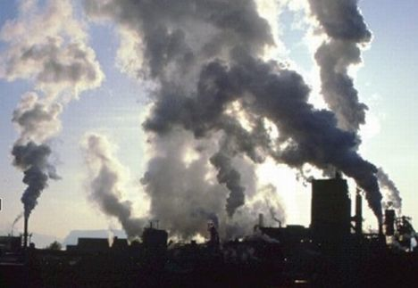
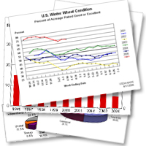
Partnership with dominant technology provider in C/A.
Product development 66% completed.
Customer pilot plant test approved. Plant visits.
Market survey sent out to C/A plant managers

Slide 159
Explored Item
Contract Design Shops
Product Development
H₂/HC Monitoring In Severe Environments
Provide infrastructure
Severe Environment Operators
Suppliers/ Manufacturers
Production
Component sourcing
Efficiency
Applications
Research Institutes and Journals
Chlorine Production
Regulatory/Insurance
Domain Suppliers
Regulatory and Government
IP and Expertise
Direct
Capital Assets
Domain Specific Suppliers
Distributors
Supplier Economics
Monitoring Services
Fixed
Sensor Sales
Sales and Marketing
Royalties

Slide 160
Value Propositions
‘Need-to-have’s
‘Nice-to-have’s
Detects specific species (typically ratio of species)
Sufficient kinetics and sensitivity
Signal reliability (no false positives/negatives)
Wireless (if high volumes)
User interface (if software)
Visualization of data
Can be display on sensor or even warning LEDs
Sensor lifetimes matching replacement cycle of another more crucial part
Extreme kinetics and sensitivity
Wireless (if low volumes)
Low-cost
Extremely Long-lasting
Detection of other species
Low-power
Minimum viable product:
It only has to work, and be easy to use

Slide 161
Accepted
Explored Item
Contract Design Shops + Suppliers/Manufacturers
Product Development
H₂/HC Monitoring In Severe Environments
Provide infrastructure
Severe Environment Operators
Production
Component sourcing
Efficiency
Domain Specific Suppliers (especially if R&D is needed)
Research Institutes and Journals
Regulatory/Insurance
Domain Suppliers, Regulatory and Government
Minimum Viable Product
Applications
IP and Expertise
Direct
Chlorine Production
Capital Assets
Reliably detect species of interest
Domain Specific Suppliers
Easy to use
…
Sync with other cycle
Distributors
Wireless(if volume)
Supplier Economics
Monitoring Services
Fixed
Sensor Sales
Sales and Marketing
Royalties

Slide 162
Channel Interviews
C/A Partner
Regional
Director of R&D
Director of Marketing
Director of Product Service
Senior Acct Managers
R&D Engineers
Global
CTO
Jeff Farbacher, CEO Accutran
Charles Noll, Marcellus Shale Development Group
Former GE Employee
Tim Fogarty, Director of IW Energy
Ed Faust, Global Marketing, Siemens
Dr. Bob Lad, President of Environetix
Emerging Markets Interviews
Jonathan Levine, Hydrate Researcher
NETL Methane Hydrate RG
Berkeley sensors group

Slide 163
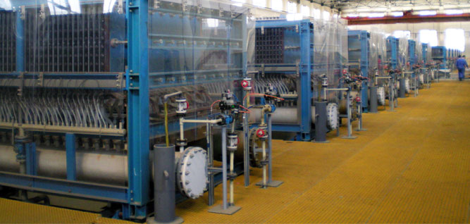
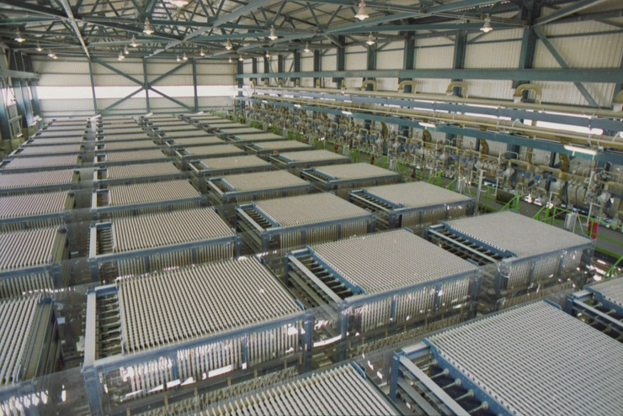
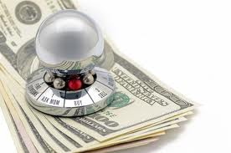
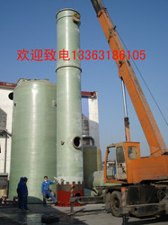
Each step process has different risk premium
Detection limit of the sensor required is different for each step of the process.
Discussions are in cell technologies
Cell Technologies
Liquifaction
Current Measurement
Gas chromatograph
Drying Towers

Slide 164
Each step process has different risk premium associated
Detection limit of the sensor required is different for each step of the process. Discussions are in cell technologies
#GOAL
Price the same product differently based on what we protect as opposed to an agglomerate value add.
Cell Technologies
Liquefaction
Current Measurement
Gas chromatograph
Drying Towers

Slide 165
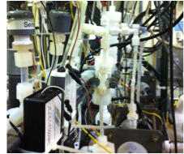
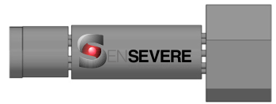
Understand Economics of Plant + Sensors
Understand Economics of
Technology Supplier
Technology Supplier

Slide 166
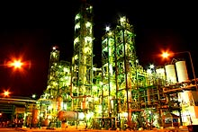
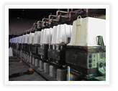
Understand Economics of Plant + Sensors
Industrial Plants
Understand Economics of
Technology Supplier
Plant #1
Plant #2
Plant #3
Technology Supplier

Slide 167
Accepted
Explored Item
Contract Design Shops + Suppliers/Manufacturers
Product Development
H₂/HC Monitoring In Severe Environments
Provide infrastructure
Severe Environment Operators
Production
Component sourcing
Efficiency
Domain Specific Suppliers (especially if R&D is needed)
Research Institutes and Journals
Regulatory/Insurance
Domain Suppliers, Regulatory and Government
Minimum Viable Product
Applications
IP and Expertise
Direct
Chlorine Production
Capital Assets
Reliably detect species of interest
Domain Specific Suppliers
Easy to use
…
Sync with other maint. cycle
Distributors
Wireless(if volume)
Supplier Economics
Monitoring Services
Fixed
Sensor Sales
Sales and Marketing
Royalties

Slide 168


Diaphragm
Membrane
Operational conditions
Capital cost per incident
Downtime per incident
# of cells protected
Time between incidents
Number of cells, US and worldwide
$240/MT Cl2
Cost of damages + downtime per incident per year
Value per unit per year
Diaphragm | Membrane | Membrane Header
$2,500 | $270 | $10,600

Slide 169

Soft product launch projected for Q1-Q2 2012
General launch projected for Q4 2012
Diaphragm | Membrane | Membrane Header
$2,500 | $270 | $10,600
Year | Type | % | Revenue [/year]
1 | Innovators (US) | 2.5 | $271,500
Operating costs for 1st year projected to be $350,000
2 | Early Adopters | 16 | $15,040,000
3 | Early Majority | 50 | $47,000,000
4 | Late Majority | 84 | $78,960,000
 | Full Penetration | 100 | $94,000,000

Slide 170


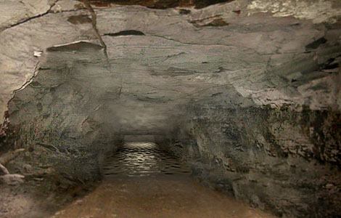

Low Volume / High Customization
Where do they get their sensors?
Specialized systems distributors
Will fund R&D
Existing channel into markets
Specialized sensor providers
Industry technology providers
Will fund R&D
Excellent channel into specific market
Current Chlor-alkali Partner

Slide 171
Contract Design Shops
Product Development
H₂/HC Monitoring In Severe Environments
Provide infrastructure
Severe Environment Operators
Suppliers/ Manufacturers
Production
Component sourcing
Applications
Safety
Research Institutes and Journals
Chlorine Production
Efficiency
Domain Suppliers
Environmental
Regulatory and Government
IP and Expertise
Direct
Capital Assets
Domain Specific Suppliers
Distributors
Supplier Economics
Monitoring Services
Fixed
Sensor Sales
Sales and Marketing
Royalties

Slide 172
Contract Design Shops
Product Development
H₂/HC Monitoring In Severe Environments
Provide infrastructure
Severe Environment Operators
Suppliers/ Manufacturers
Production
Component sourcing
Safety
Applications
Research Institutes and Journals
Chlorine Production
Efficiency
Domain Suppliers
Environmental
Regulatory and Government
IP and Expertise
Direct
Capital Assets
Domain Specific Suppliers
Distributors
Supplier Economics
Monitoring Services
Fixed
Sensor Sales
Sales and Marketing
Royalties

Slide 173
Contract Design Shops + Suppliers/Manufacturers
Product Development
H₂/HC Monitoring In Severe Environments
Provide infrastructure
Severe Environment Operators
Production
Component sourcing
Efficiency
Domain Specific Suppliers (especially if R&D is needed)
Research Institutes and Journals
Regulatory/Insurance
Domain Suppliers, Regulatory and Government
Minimum Viable Product
Applications
IP and Expertise
Direct
Chlorine Production
Capital Assets
Reliably detect species of interest
Domain Specific Suppliers
Oil and Gas
Easy to use
Sync with other cycle
Distributors
Power Infrastructure
Wireless(if volume)
…
Supplier Economics
Monitoring Services
Fixed
Sensor Sales
Sales and Marketing
Royalties

Slide 174
Contract Design Shops + Suppliers/Manufacturers
Product Development
H₂/HC Monitoring In Severe Environments
Provide infrastructure
Severe Environment Operators
Production
Component sourcing
Efficiency
Domain Specific Suppliers (especially if R&D is needed)
Research Institutes and Journals
Regulatory/Insurance
Domain Suppliers, Regulatory and Government
Minimum Viable Product
Applications
IP and Expertise
Direct
Chlorine Production
Capital Assets
Reliably detect species of interest
Domain Specific Suppliers
Oil and Gas
Easy to use
Sync with other maint. cycle
Distributors
Power Infrastructure
Wireless(if volume)
…
Supplier Economics
Monitoring Services
Fixed
Sensor Sales
Sales and Marketing
Royalties

Slide 175
Accepted
Explored Item
Contract Design Shops + Suppliers/Manufacturers
Product Development
H₂/HC Monitoring In Severe Environments
Provide infrastructure
Severe Environment Operators
Production
Component sourcing
Efficiency
Domain Specific Suppliers (especially if R&D is needed)
Research Institutes and Journals
Regulatory/Insurance
Domain Suppliers, Regulatory and Government
Minimum Viable Product
Applications
IP and Expertise
Direct
Chlorine Production
Capital Assets
Reliably detect species of interest
Domain Specific Suppliers
Easy to use
…
Sync with other maint. cycle
Distributors
Wireless(if volume)
Supplier Economics
Monitoring Services
Fixed
Sensor Sales
Sales and Marketing
Royalties

Slide 176


Slide 177

CUSTOMER SEGMENTS
which customers and users are you serving?
which jobs do they really want to get done?

Slide 178

VALUE PROPOSITIONS
what are you offering them? what is that
getting done for them? do they care?

Slide 179

CHANNELS
how does each customer segment want to be reached? through which interaction points?

Slide 180

CUSTOMER RELATIONSHIPS
what relationships are you establishing with each segment? personal? automated? acquisitive? retentive?

Slide 181

REVENUE STREAMS
what are customers really willing to pay for? how?
are you generating transactional or recurring revenues?

Slide 182

KEY RESOURCES
which resources underpin your business model? which assets are essential?

Slide 183

KEY ACTIVITIES
which activities do you need to perform well in your business model? what is crucial?
183

Slide 184

KEY PARTNERS
which partners and suppliers leverage your model?
who do you need to rely on?

Slide 185

COST STRUCTURE
what is the resulting cost structure?
which key elements drive your costs?

Slide 186
key activities
value proposition
customer relationships
key partners
customer segments
cost structure
revenue streams
key
resources
channels
186
images by JAM

